Slide 1
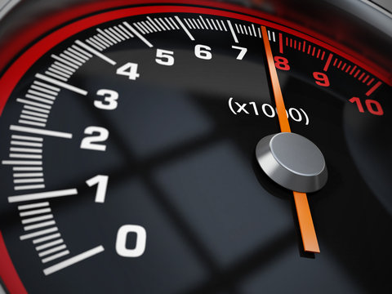

Team 26: DC Motor Rotation Control Bi-Weekly Update 5
Zachary Bauman, Terrance Smith, Rodene Corpuz-Roxas, Josiah Thompson
Sponsor: Aniruddha Datta
TA: Manoj Kumar Balamurugan

Slide 2
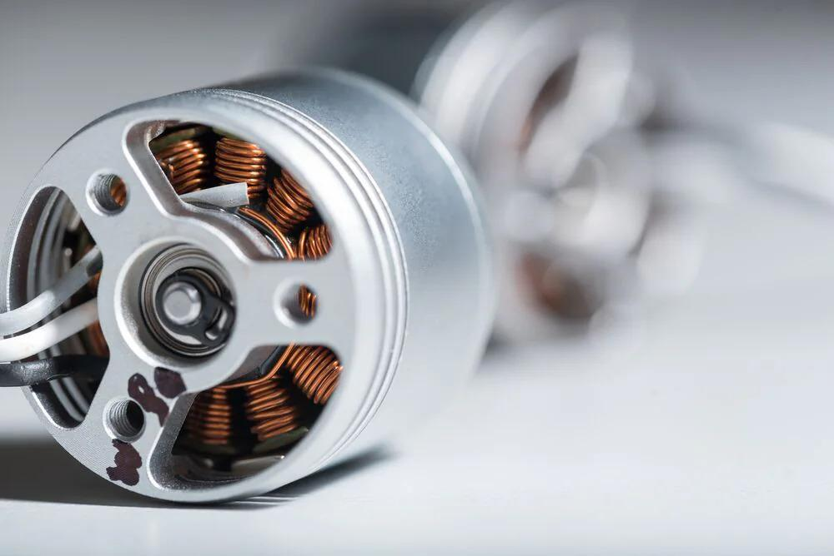
Project Summary
Problem statement:
Motors are everywhere, even in hazardous areas. And all motors need to be controlled even when an operator is not physically present.
Our Solution:
Create a custom DC motor controller that is safe and intuitive for the user.

Slide 3
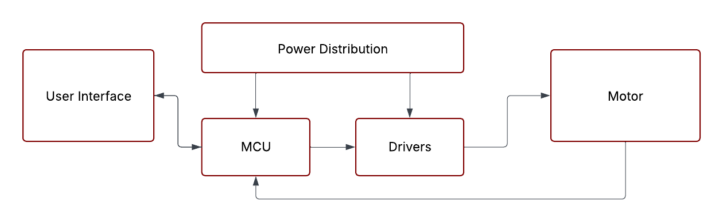
System Overview
Rodene Corpuz-Roxas
Bluetooth
Zachary Bauman
Terrance Smith
Josiah Thompson
Notes:
Cloud server and database

Slide 4
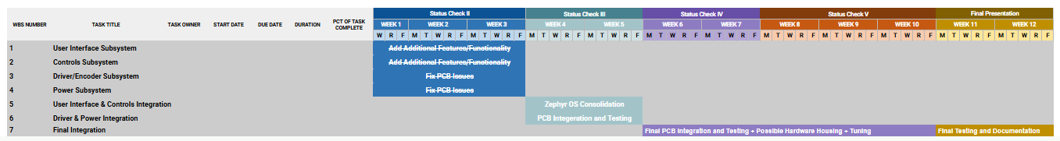
Project Timeline
Notes:
Cloud server and database

Slide 5
User Interface & Control System Integration
Zachary Bauman
Accomplishments since last update 24 hrs of effort | Ongoing progress/problems and plans until the next presentation
Integrated the new control logic (new commutation step table, soft-start sequences, and bootstrap cap. logic) With the Test Driver: Successful bidirection data flow: motor responds and spins to the RPM requests from the Android app, and real-time motor RPM data is relayed to the user interface. | RPM calculation inaccuracy: the motor is currently reporting an RPM value that's only 63% of the requested RPM value (4k rpm is outputting 2.5k rpm). PI Controller Tuning: The PI logic is settling for the RPM value that is 63% of the target value; otherwise, the behavior is correct. Test and tune system with the custom driver/controller.

Slide 6
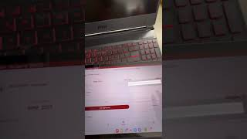
UI and Control Integration Demo video

Slide 7
Control Algorithm
Josiah Thompson
Accomplishments since last update 60+ hrs of effort | Ongoing progress/problems and plans until the next presentation
Control algorithm runs partially integrated with UI (counter clockwise spin working with full motor function) Control algorithm integration with custom driver | Fix RPM measurement with integrated driver Fix startup on the control algorithm Run and verify bidirectional control with full integration Program custom MCU once PCB complete

Slide 8
Custom driver/controller and Control system integration
Terrance Smith
Accomplishments since last update 20 hours | Ongoing progress/problems and plans until the next presentation
Complete integration with control systems Smooth and complete rotations with MCU | One of the phase driver ICs heats up after some time while activated Desolder barrel jack to allow power pcb to be main source of power. Input component into the printed housing Finish soldering of mcu pcb

Slide 9
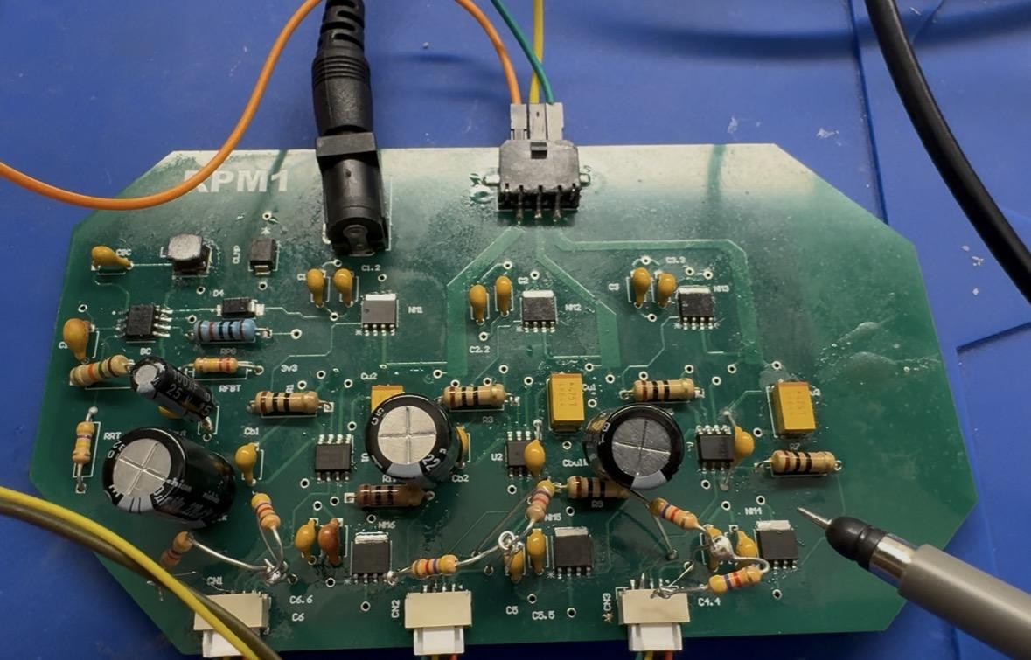
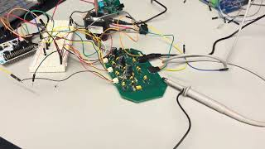
Custom Controller/Driver
Terrance Smith
Integration Results

Slide 10
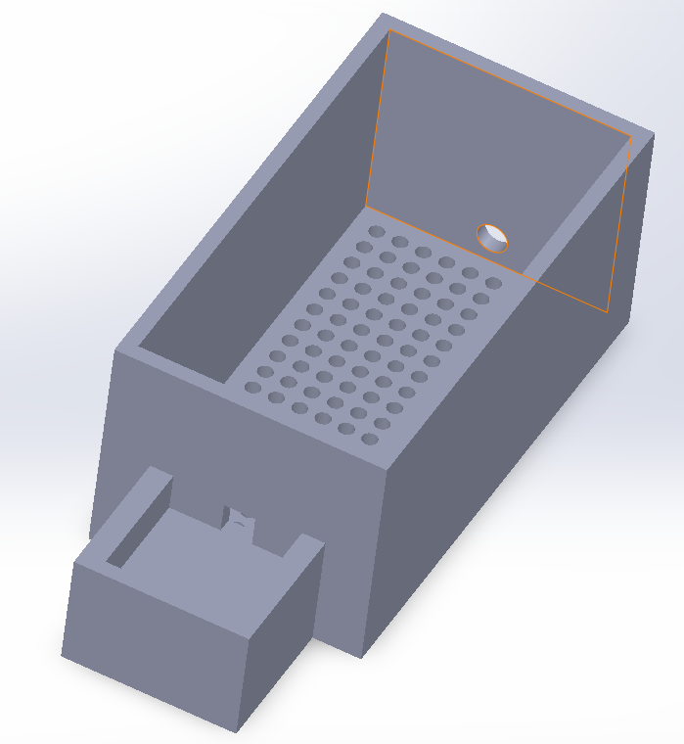
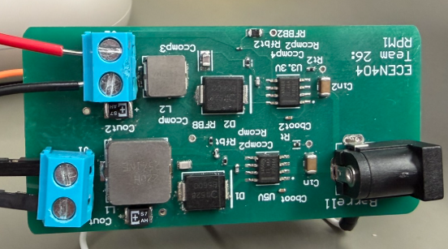
Power/Housing Rodene
PCB is tasked with converting wall input into output power supply for control system
Housing to contain all components of the integrated control

Slide 11
Power Rodene Corpuz-Roxas
Accomplishments since 403 10 hours | Ongoing progress/problems and plans until the next presentation
Housing design completed Switch added to power PCB | 3D print housing for the entire integrated system Solder microprocessor onto MCU PCB

Slide 12
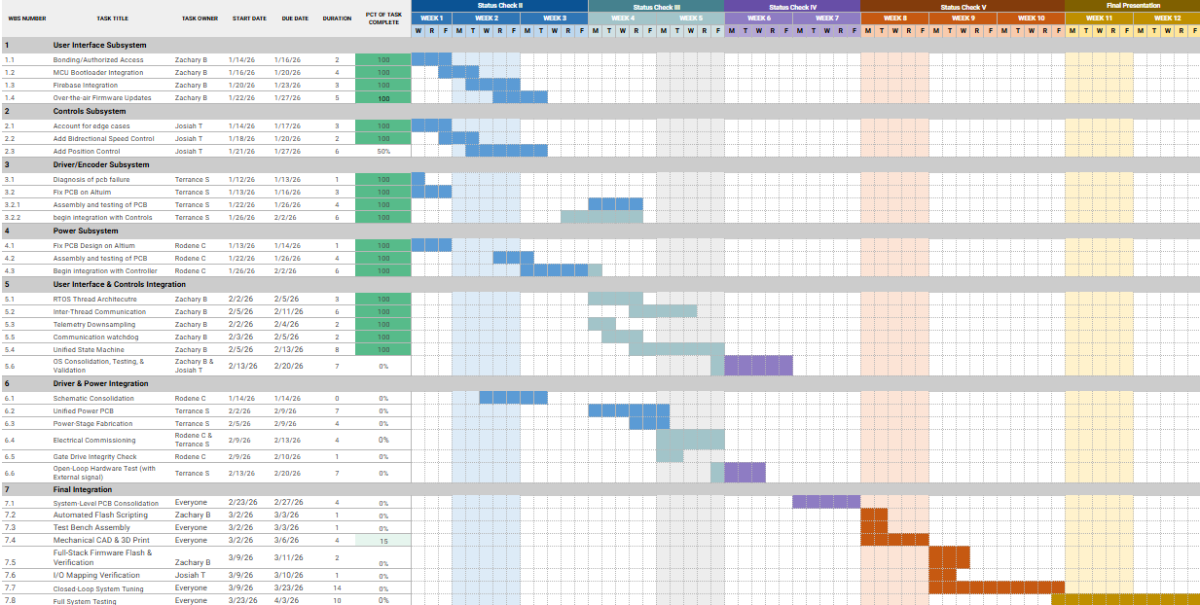
Execution Plan
Notes:
Michelle

Slide 13
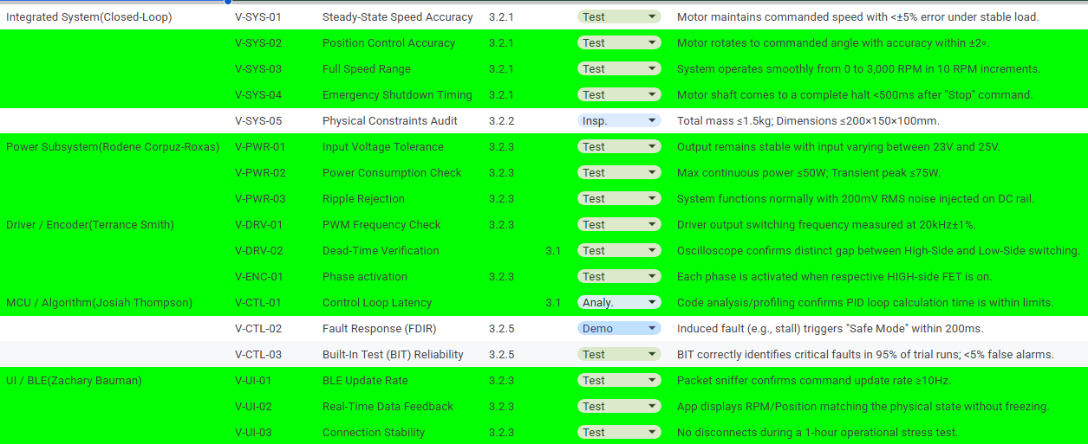
Validation Plan
Notes:
Michelle

Slide 14
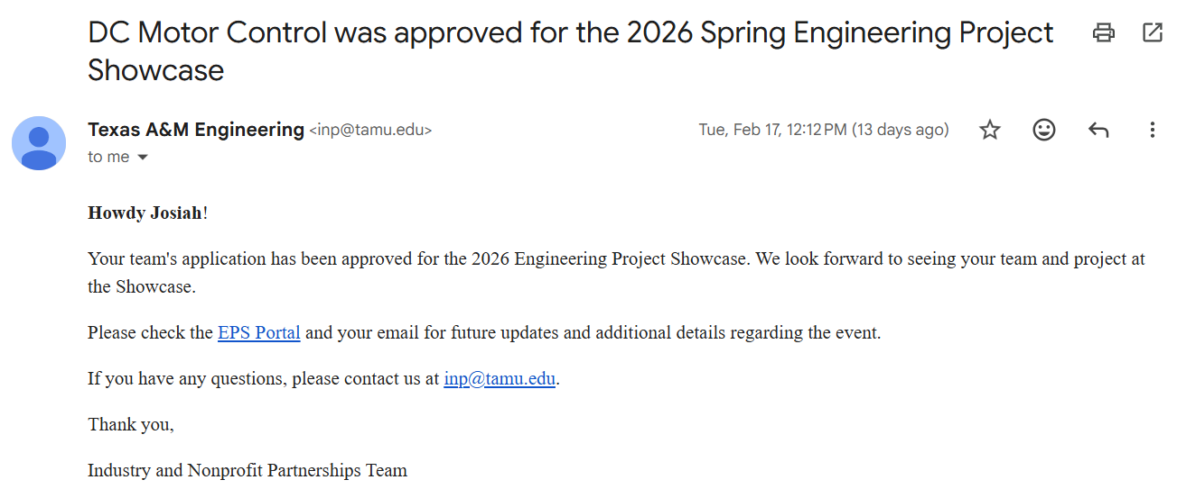

Slide 15
Team 26: RPM1
Thanks & Gig’em
‹#›

